Slide 1
Desired State Configuration
An overview, introduction and quick start
Richard Siddaway

Slide 2
About_Author
PowerShell MVP
Author
Blogger
Director of PowerShell.org
Organise NA Summits and 2 European Summits
11+ years PowerShell
25+ years IT

Slide 3
CIM workshop this afternoon
Can take time from that for DSC if we don‘t finish
Your choice

Slide 4
Questions?
As we go please
This will (hopefully) be interactive

Slide 5
Agenda
Mainly by demo
DSC components
First configuration
Configuring LCM
Parameterising configurations
Nested configurations
Creating and using a pull server
Creating DSC resources

Slide 6
Terminology
Resource – code to perform configuration
  Needs get; set and test methods
  Resources packaged in modules
  Think of them like cmdlets from a module
Local Configuration Manager
  Runs on target machine
  Applies configuration
Push server – configurations pushed manually
Pull server – automated deployment

Slide 7
DSC Process
Gather resources
Write configuration
Create MOF file
MOF file -> target machine
LCM applies configuration

Slide 8
DSC versions => expect MOF file conflicts
DSC changed at each point:
Windows 2012 R2 RTM – July 2013
Windows 2012 R2 GA – October 2013
Windows 2012 R2 Update – November 2014
DSC for Linux – version 1.0 & 1.1
WMF 4.0 update for Windows 2012 & 2008 R2
WMF 5.0 RTM
Windows 2016 & WMF 5.1 (?)

Slide 9
Recommendation
Use a single version of WMF
preferably 5.0
across all DSC servers
and targets

Slide 10
DSC and DevOps
Where does DSC fit into DevOps

Slide 11
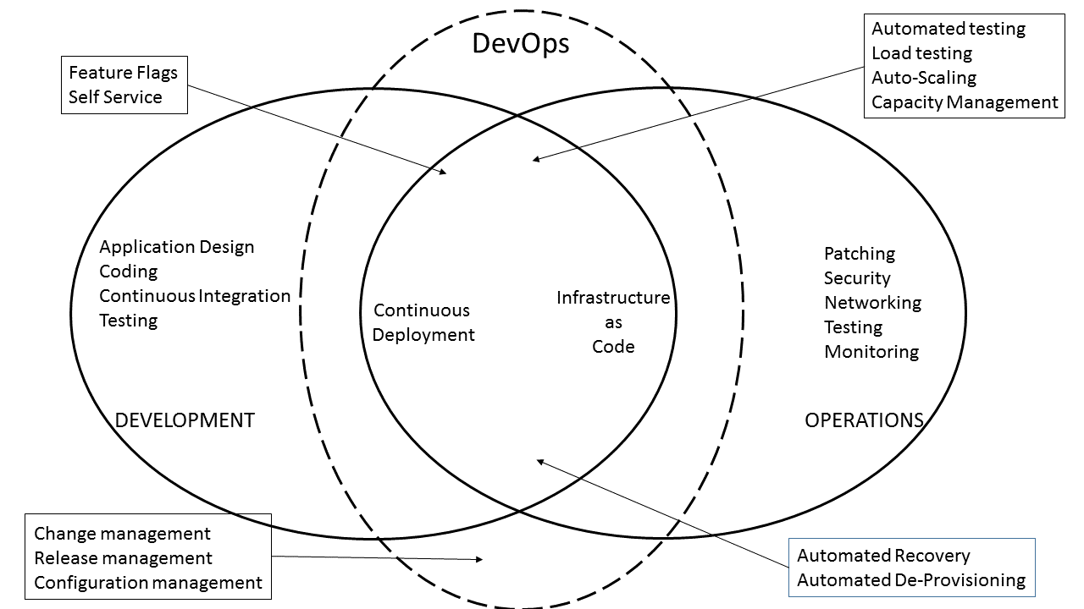

Slide 12


Slide 13
Make
It
So

Slide 14
DEMO time

Slide 15
Summary
DSC is for configuring servers
Components
  Resources, LCM, configurations, MOF files
Push or pull modes
USE SOURCE CONTROL ON YOUR CONFIGURATIONS

Slide 16
Questions?

Slide 17
Simple Console Demos
# Embed one-liners right into your slides:
PS> Get-ExecutionPolicy
Bypass

Slide 18
Demo
Use the ISE-style demo slides
to show code
To insert color-coded code, insert the code into a real ISE
script pane,

Slide 19
# simply enter code into a REAL ISE script pane
# then select all, copy, and paste the code
# into this slide
# in the overlay toolbox window that appears in the
# slide, choose KEEP FORMATTING
# to keep the color-coding
Get-Audience |
Add-Speaker -Level GodlikeBeing |
Out-PowerShellExtravaganza

Slide 20
Next Steps...
Now: 15 min break
Grab a coffee
Stay here to enjoy next presentation
Change track and switch to another room
Ask me questions or meet me in a breakout session room afterwards

